Slide 1
Lecture 02: Visualization Design Pipeline
DS 4200
Spring 2023
Prof. Ab Mosca (they/them)
Northeastern University
Slides and inspiration from Cody Dunne, Michelle Borkin, Remco Chang, Dylan Cashman, Krzysztof Gajos, Hanspeter Pfister,
Miriah Meyer, Jonathan Schwabish, and David Sprague

Slide 2
Today
Visualization Design Pipeline
Finish ic-01

Slide 3
Note
hw-01 is out today!
It is a partner assignment – use the find a partner post on piazza, or the break in class to find a partner

Slide 4
Visualization Design Pipeline

Slide 5
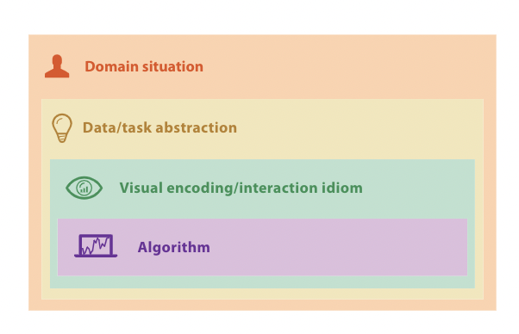
Munzner’s Nested Model
Nested Model
Validation
Notes:
The pipeline we’ll be working off in this class is Tamara Munzner’s Nested Model of visualization design.
You’ll see in this model, there are 4 main steps to visualization design.
The first is Domain situation, or in other words understanding the domain scenario in which your visualization would be used. For example, understanding a scientists workflow before making a visualization to help them analyze experiments.
The second step is Data/Task abstraction. That means understanding what data you will be visualizing, and understanding what tasks your final visualization needs to support.
The third step is visual encoding / interaction idiom. This refers to picking the actual design and functionality of your visualization tool.
And the last step is algorithm, which for our purposes we’re going to consider as just the step of actually building the visualization.
Let’s look at what goes into each of these steps in a little more detail.

Slide 6
Understanding a Domain Situation
Domain Situation
Target Users
Current Workflow
Expertise
Purpose
Notes:
First, understanding a domain situation.
This includes understanding your target users and the purpose of your visualization.
When we say understand the target users we mean understand how they currently solve the problem you are proposing to solve with visualization, and understand what areas of expertise they have.
For example, let’s go back to the scientist example. Say that scientist asked for a visualization tool to help analyze experimental data. Before you start designing that tool it is important to understand how the scientist currently analyzes her data. What tools does she use? What steps does she take? Are any steps in particular difficult, time consuming, or tedious? Are any steps in particular really simple or really important to keep as is?
Similarly, we’ll need to know the purpose of the visualization tool. For the scientists example we might want to know if the tool will always be used to run one type of analysis, for example a regression analysis, or if the scientist needs a more flexible tool that helps her look at her data and generate new hypotheses for every experiment.

Slide 7
Understanding Data / Task
Data / Task Abstraction
Data
Low-level workflow steps
Task
Ethics / Biases
Types
Source
Quality
Desired outcome
Notes:
Once we understand the scenario in which our visualization tool would be used we need to understand the data it will show and the specific visualization tasks it will be used for.
Understanding the data we’ll be showing includes analyzing where the data comes from, i.e. its source, looking for any potential biases or ethical issues the data might include.
For example, if your data is a sample of a population does it have demographics that are representative of the larger population it represents? Are there an important groups not represented in your data that should be? Are there systemic biases present in your data that you should highlight for your user or that you should attempt to correct? Similarly, is the data ethically sourced and okay to release to your target users? Are there any privacy or security concerns?
When we’re understanding our data we’ll also want to look at the different types of data included in what we will visualize, and we’ll want to take a look at the quality of our data. For example, are there any missing values, outliers, unusual distributions etc?
Understanding the task our visualization will support boils down to understanding the low-level visualization tasks we need to represent. For example comparing trends vs finding outliers. And also understanding the desired outcome or goal of the visualization tool. Should it help compare two distributions? Is its main purpose to communicate information to the user or to help the user explore data? Etc.
We’ll talk more about data and task abstraction in future lectures so don’t worry too much if they seem vague at this point.

Slide 8
Visual Encoding / Interaction Idiom
Visual Encoding / Interaction Idiom
Data Types
Low-level Visualization Tasks
User’s Expertise
Notes:
The next step in the design pipeline is deciding on a Visual encoding / interaction idiom.
What this means is actually designing the visualization tool. What will it look like and how will the user be able to interact with it.
For example, should we use a bar chart or a line chart? Should it be interactive? Do we need multiple coordinated visualizations? If so, how will we coordinate them?
An important thing to stress here is that the previous steps we took to understand our data, tasks, and the user all inform the visual encoding / interaction idiom we will ultimately choose.
Again, we’ll spend multiple lectures on this topic later on, so don’t worry if it feels vague for now.

Slide 9
Algorithm
Visual Encoding / Interaction Idiom (Visualization Design)
Algorithm / Implementation
Notes:
The final step of the design pipeline is the algorithm, or in other words taking the visualization we designed in the previous step and actually building it.
Tamara call’s this step Algorithm, because often it amounts to actually coding a visualization tool from scratch, but this step could also be done with tools like Tableau.

Slide 10

Munzner’s Nested Model
Human-Centered, Iterative Design
Design
Evaluate
Validation
Notes:
So to recap. We just walked through the stages of Munzner’s Nested Model for visualization design. When you probably noticed from the name of the model and what we just talked about is that each step in this process depends on the previous step. In other words, we cannot perform data and task abstraction without an understanding of the domain situation, and similarly we can design a visual encoding without understanding out data and tasks.
One last thing I want to point out here is that this process should be human-centered and iterative. What does that mean?
Well, it means that we should inform what we are building and how we build it based on our end users’ needs and goals. In other words, we need to understand the end users unique needs and preferences and build to meet those instead of guessing or deciding what the user needs without consulting them.
Iterative design means that we loop through this process multiple times. We talk to the user, design something for them, and then go back to the user to evaluate what we’ve built so far. Based on user feedback, we redesign as needed.
Let’s look at some examples of how we gain an understanding from our end users of what they need.

Slide 11


Human-Centered Design
What do you need a visualization for?
I want to see how my students are doing from year to year.
Notes:
Human centered design often starts with an interview of the end user for the tool we are building.
For example, let’s say you are designing a visualization tool for a teacher. An interview for that might go something like this.
First you’d ask what the teacher needs the tool for.
Let’s say in this case the teacher says they want a tool to see how their students are doing from year to year.
This gives you a decent idea of the domain situation you are working with (a teacher who wants to track yearly progress), but it’s a little vague. Can anyone suggest some different ways we could measure or show how students are doing from year to year?
We need follow up questions to see which of these is best for this situation.

Slide 12
Human-Centered Design
What do you need a visualization for?
I want to see how my students are doing from year to year.
How do you measure student success?
Validation
Notes:
So let’s say in order to do that you ask as a follow up how do you measure student success? This is a question designed to help understand what type of data you will be visualizing.

Slide 13
Human-Centered Design
What do you need a visualization for?
I want to see how my students are doing from year to year.
How do you measure student success?
Validation
Final grades in the class.
Notes:
Let’s say the teacher answers Final grades in the class.
This starts to hint at the data you’ll visualize, but its not very specific.

Slide 14
Human-Centered Design
What do you need a visualization for?
I want to see how my students are doing from year to year.
How do you measure student success?
Validation
Final grades in the class.
What kinds of comparisons or statistics do you need?
Notes:
So as a follow up you’d probably ask something like what kinds of comparisons or statistics do you need?
This is another question aimed at understanding what you will be visualizing and what exactly the teacher needs help seeing.

Slide 15
Human-Centered Design
What do you need a visualization for?
I want to see how my students are doing from year to year.
How do you measure student success?
Validation
Final grades in the class.
To compare the average final grade of each class since I started teaching.
What kinds of comparisons or statistics do you need?
Notes:
Let’s say the teacher answers this question with a relatively complete answer: to compare average grade of each class since they started teaching.
Now you know what data you’ll be visualizing (average grade per class per year), and what task the teacher needs support with, i.e. comparisons year to year and seeing trends over the years.
Next, we need to think of the correct visualization for this task. Any ideas on visualizations we could use?

Slide 16
Human-Centered Design
What do you need a visualization for?
I want to see how my students are doing from year to year.
How do you measure student success?
Validation
Final grades in the class.
To compare average grade of each class since I started teaching.
What kinds of comparisons or statistics do you need?
I’ll start with a line chart showing average grade per year.
I’ll code it in Tableau.
Notes:
From there, you would start designing the visualization you think could help the teacher.
For example you might start by making a line chart that emphasizes trends in average grade per class over the years.
Once you know what you want to build, you decide to use tableau to start building it.
This is a paired does example of how the human-centered visualization design process gets started. We move through the steps of Tamara’s nested model, and at each stage we inform what we’re doing by talking to our end user and attempting to understand what they want and need.

Slide 17
Human-Centered Design
Ground our designs in human needs
Gather an understanding of the domain situation from our end users
Check our work by iterating, i.e. continually verifying and evaluating our proposed visualization tool
Validation
Notes:
A few key takeaways of human-centered design: (1) it means … <read>
Next, lets look at some examples of the design process I pulled from published work.

Slide 18

Example: PROACT
Notes:
The first example we will look at is a tool called PROACT.

Slide 19
Example: PROACT
Domain Situation: Doctors need to communicate expected prognoses following active vs. conservative treatment of localized prostate cancer.
Data / Tasks: (1) Help patients understand personal risk at various years. (2) Help patients compare survival rates at various years given the two treatment options.
Notes:
The domain situation the inspired poact was … <read>
And the data / tasks that needed to be shown were … <read>
Based on these the proact team developed the following visual idiom

Slide 20
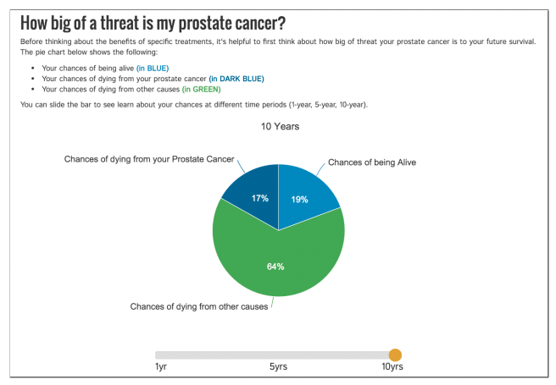
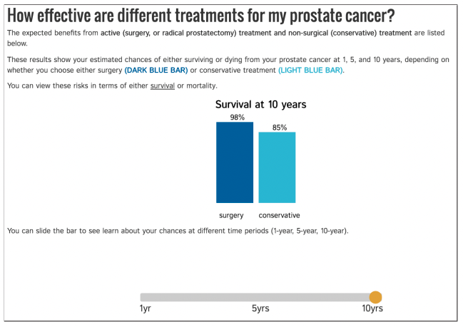
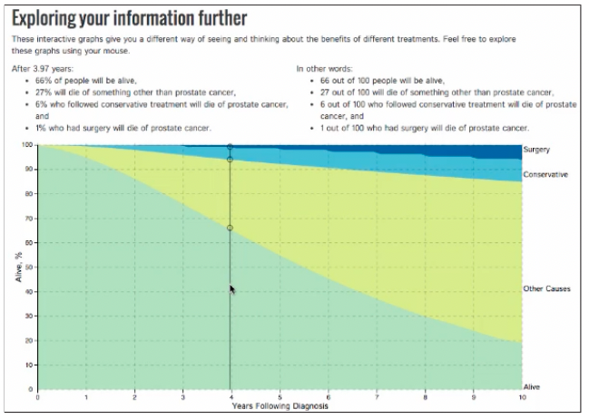
Example: PROACT
Visual Encoding / Interaction Paradigm:
Pie chart showing morbidity rates with slider for years.
Bar chart showing survival rates with slider for years.
Temporal area chart of survival rates.
Notes:
They created a series of visualizations that walk the user through various data.
On the left here is <read>
This was their first go at a visualization for this domain situation. They evaluated with with a small user study and found the following:

Slide 21
Example: PROACT
Evaluation showed…
Pie chart showing morbidity rates with slider for years.
Bar chart showing survival rates with slider for years.
Temporal area chart of survival rates.
Notes:
Sliders (interaction) was difficult for the target audience. They didn’t exactly understand it and had a hard time using it.
In addition, they found most people were unfamiliar with temporal area charts and didn’t know how to use them.
In response, the team redesigned proact as follows

Slide 22
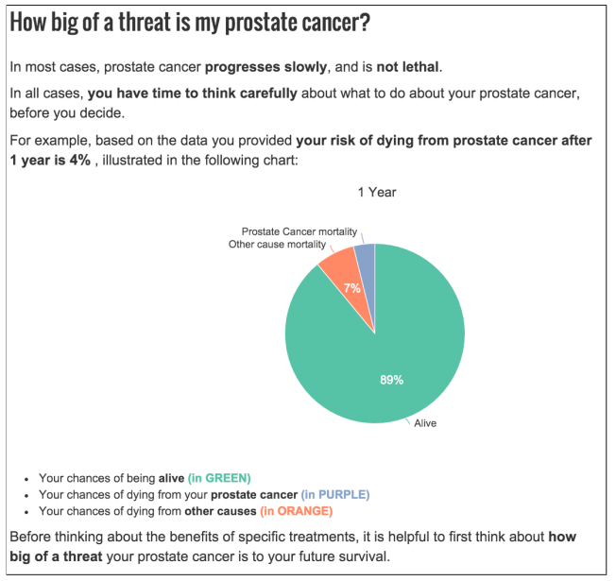
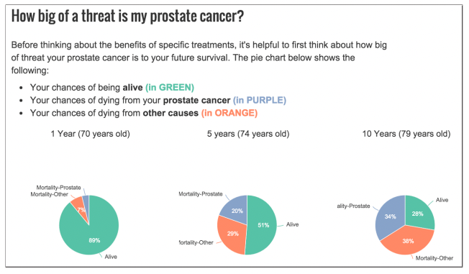
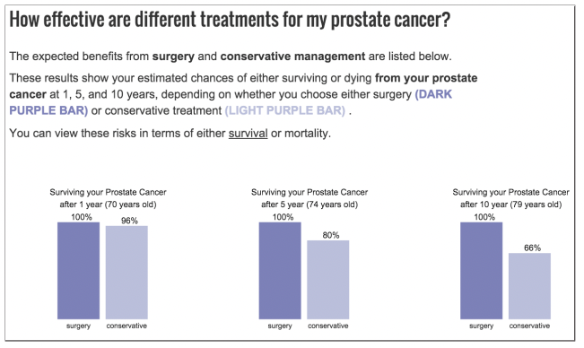
Example: PROACT
REVISED Visual Encoding / Interaction Paradigm:
Pie chart with 1 year survival.
Pie charts showing morbidity rates over years.
Bar charts showing survival rates over years.
Notes:
They added a single pie chart that focus on 1 year survival, to help the user feel hopeful and calmer.
They removed sliders and instead put charts side-by-side.
And they removed the temporal area chart.
When they tested this version of the tool, they had much better results that with the first version. This is because they listened to their end users are redesigned to meet their needs.

Slide 23
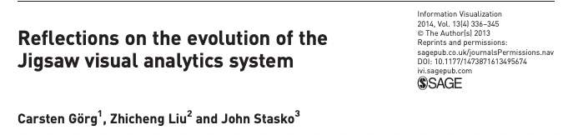
Example: Jigsaw
Notes:
Next we’ll look at another example called jigsaw.

Slide 24
Example: Jigsaw
Domain Situation: Intelligence analysts need to analyze collections of text for connections.
Data / Tasks: Group documents based on shared people, places, organizations, etc..
Notes:
Jigsaw was designed for this domain situation and these data/tasks.

Slide 25
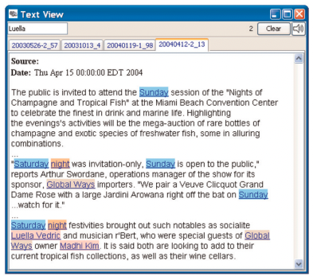
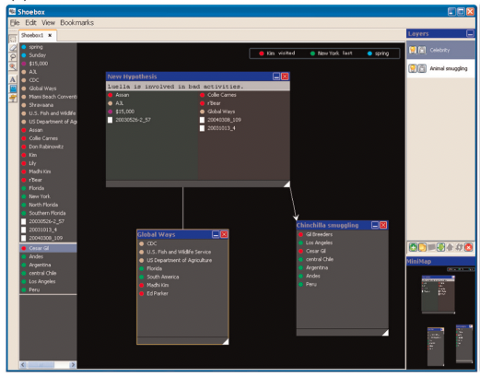
Example: Jigsaw
Visual Encoding / Interaction Paradigm:
Documents shown in tabs with entities highlighted.
Manual note taking with automated layout.
Notes:
Based on that domain situation, data, and tasks, this is the first version of jigsaw the team developed. It includes <read>
Similar to proact, the jigsaw team iteratively improved on this design based on user feedback.

Slide 26
Example: Jigsaw
Visual Encoding / Interaction Paradigm:
Documents shown in tabs with entities highlighted. Not enough information.
Manual note taking with automated layout. Not enough flexibility.
Notes:
They learned from evaluations that the tabs they were showing documents in were difficult to navigate, that their notetaking area was not flexible enough, and that in general not enough information was being shown.
So they redesigned the tool as follows:

Slide 27
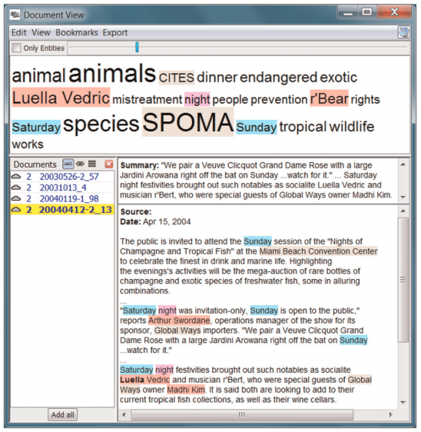
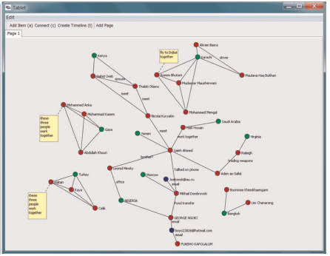
Example: Jigsaw
REVISED Visual Encoding / Interaction Paradigm:
Documents shown in scrollable list with tag cloud and 1 sentence summary.
Freestyle organization (drag & drop), with ability to draw links and add post-it notes.
Notes:
For the document view of the tool they added a word cloud to show prevalence of different document tags, a scrollable list of documents, and a 1 sentence summary of whatever document is currently selected.
For the notetaking area, they drastically increased flexibility, adding drag and drop functionality, the ability to draw links, and “post it note” functionality.
Based on user feedback, this later version of jigsaw was much more usable and helpful for analysts.

Slide 28
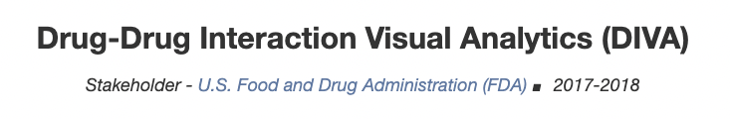

Example: DIVA
https://tkakar.github.io/Website/DIVA.html
Notes:
The last example I want to go through today is a tool called DIVA. This tool actually has an associated website that really clearly walks through the team’s design process.

Slide 29
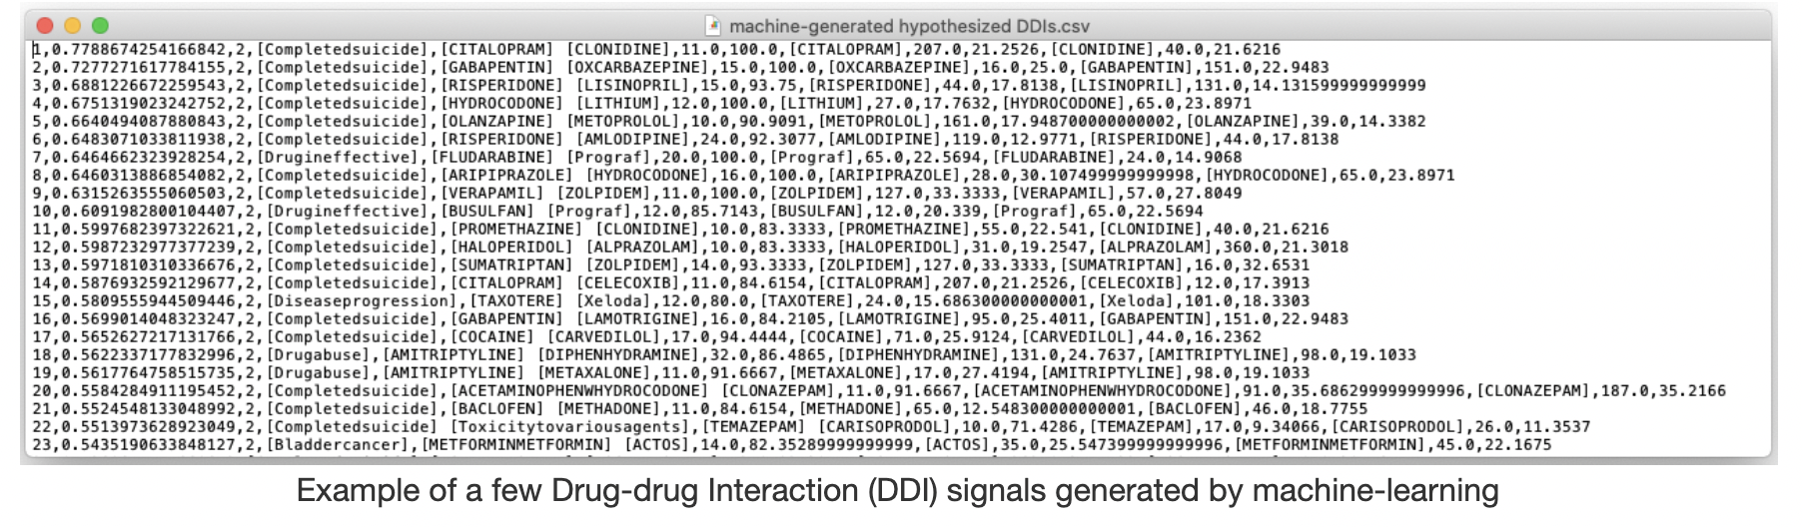
Example: DIVA
Domain Situation: FDA Analysts need to detect adverse reactions caused by drug-drug interactions (DDI).
Data / Tasks: Validate potential DDI signals in ML output.
https://tkakar.github.io/Website/DIVA.html
Notes:
First off, the domain situation DIVA addresses is: …
And the data / tasks are ..

Slide 30
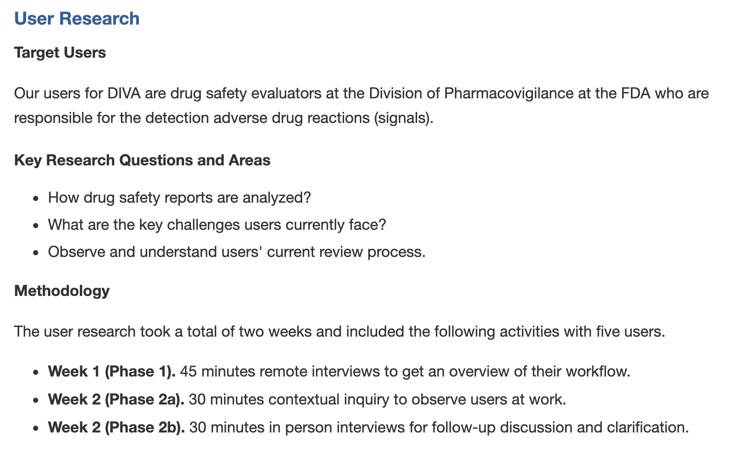
Example: DIVA
https://tkakar.github.io/Website/DIVA.html
Notes:
To inform their preliminary design, they start with user research, just like our example earlier.
They first identify their target users, which in this case are …
They also identify key research questions, and lay out their method for answering these questions.

Slide 31
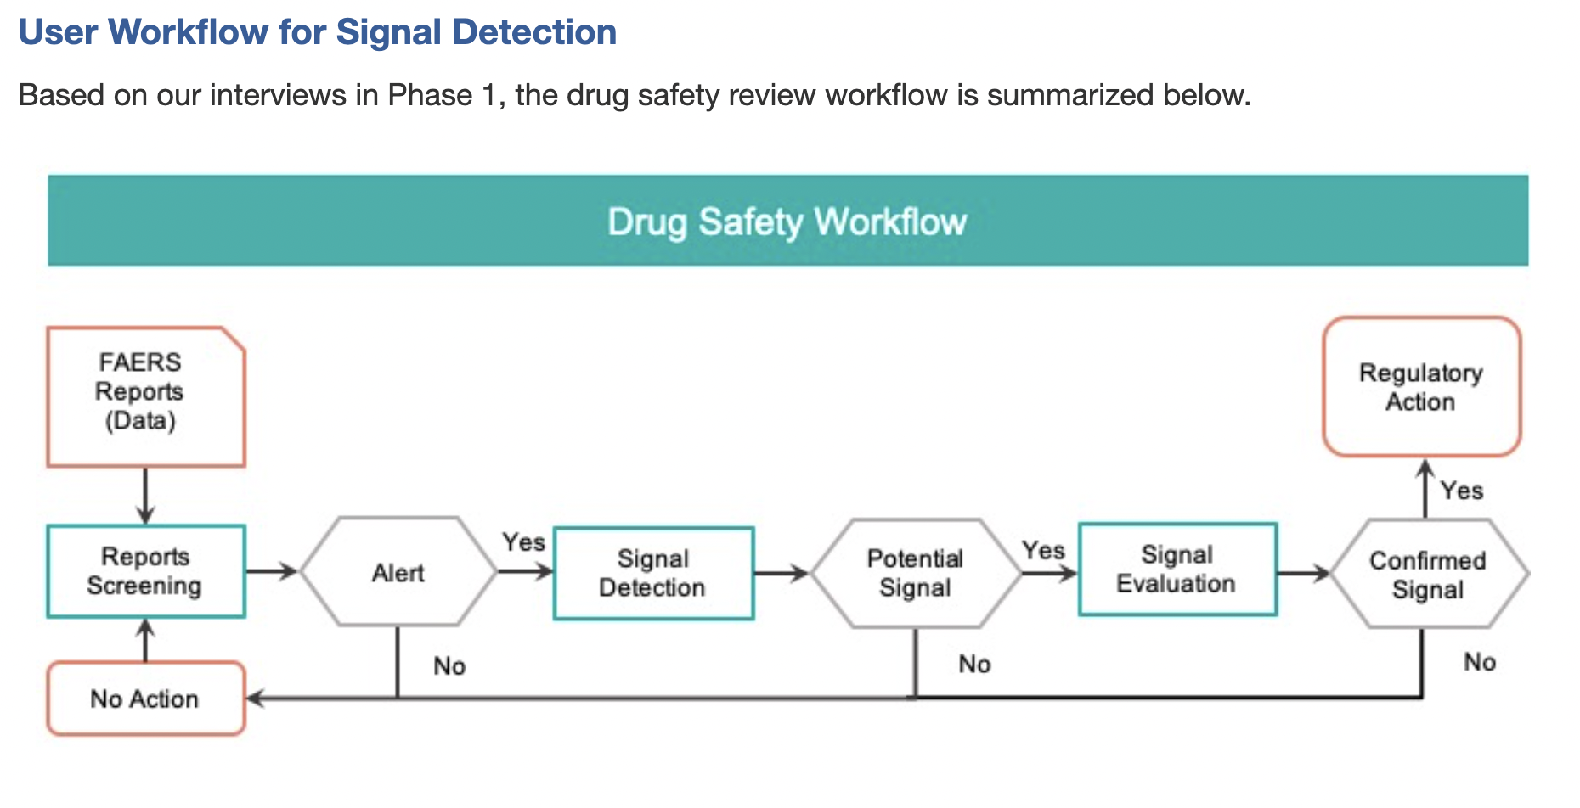
Example: DIVA
https://tkakar.github.io/Website/DIVA.html
Notes:
Based on their series of interviews with end users, they authors distill this workflow for DDI identification. In other words, this is a visualization of how analysis currently perform the task that DIVA will ultimately help support.

Slide 32
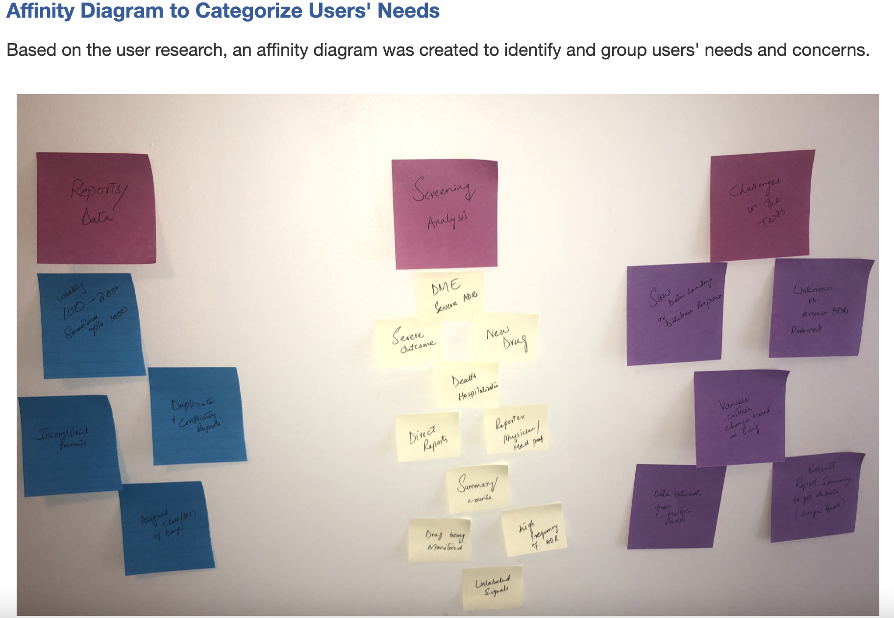
Example: DIVA
https://tkakar.github.io/Website/DIVA.html
Notes:
In addition, the authors analyzed their interviews in order to identify user needs, or in other words, what specific tasks DIVA should help with.

Slide 33
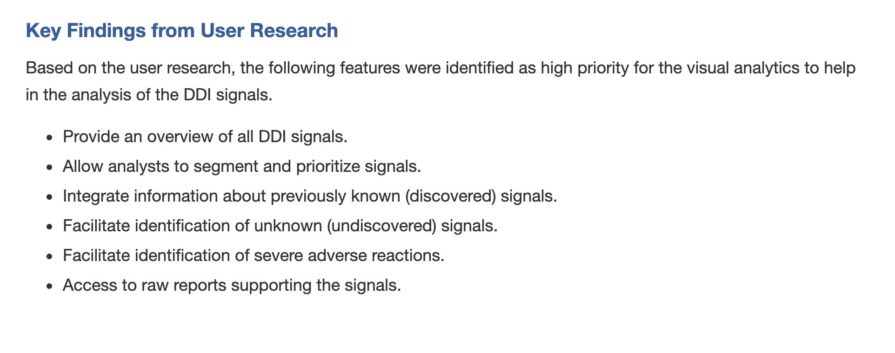
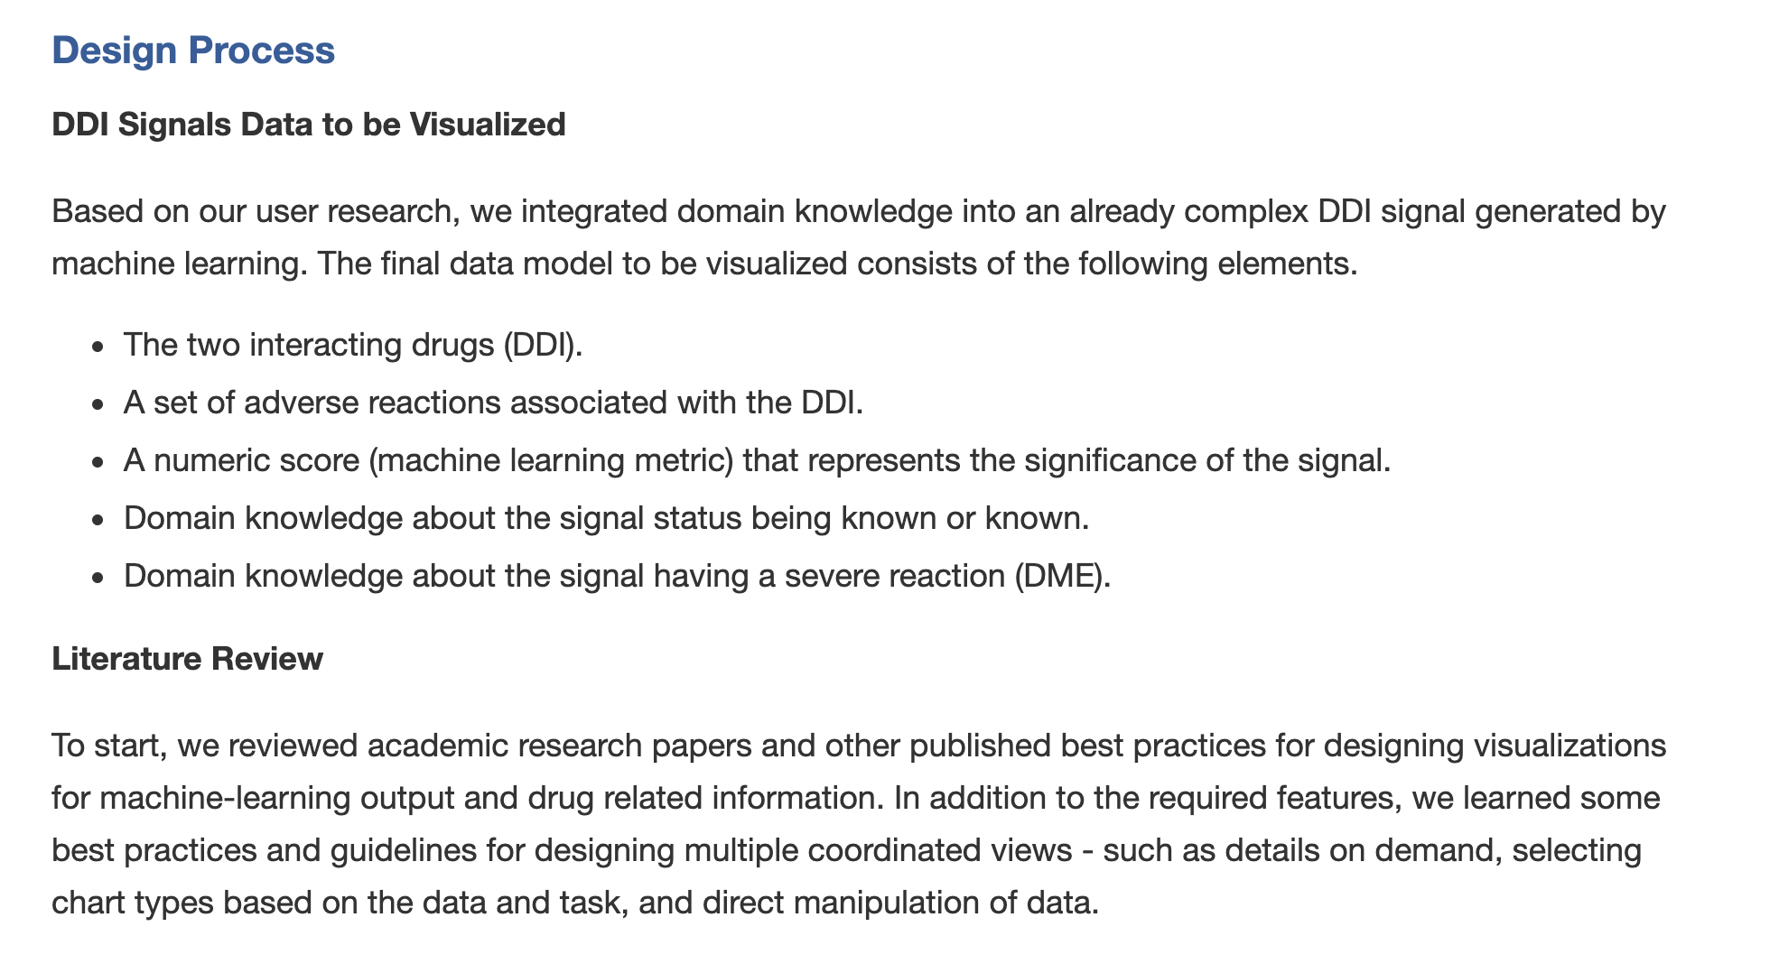
Example: DIVA
https://tkakar.github.io/Website/DIVA.html
Notes:
Specifically, they identify several high priority items to design for: <read>, and layout what they plan to visualize to support those priority items.

Slide 34
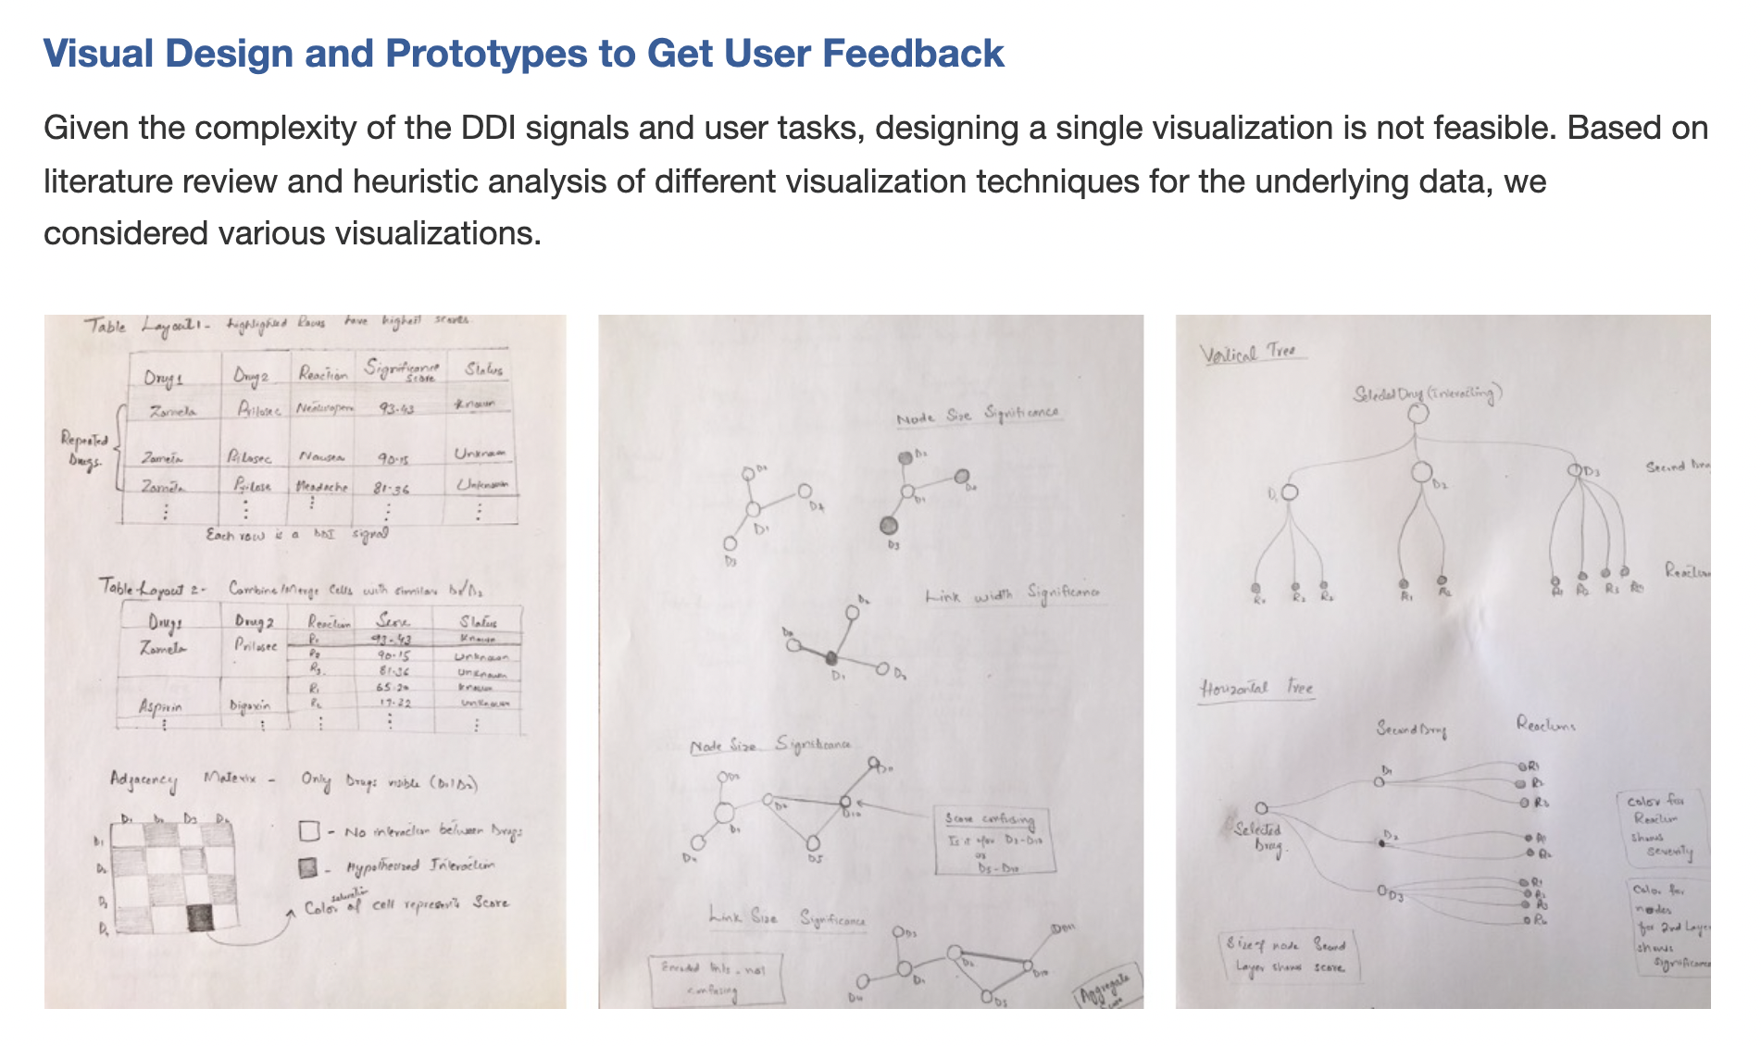
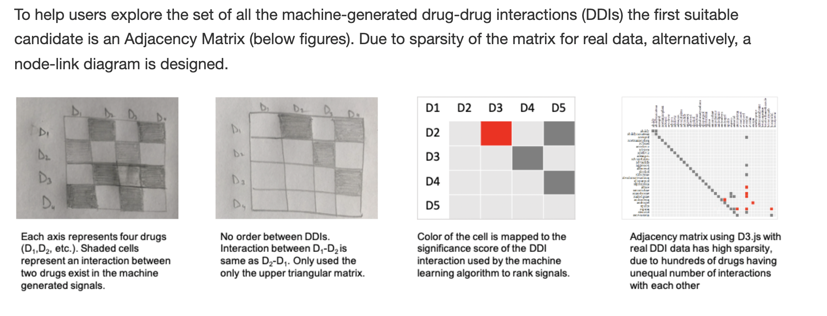
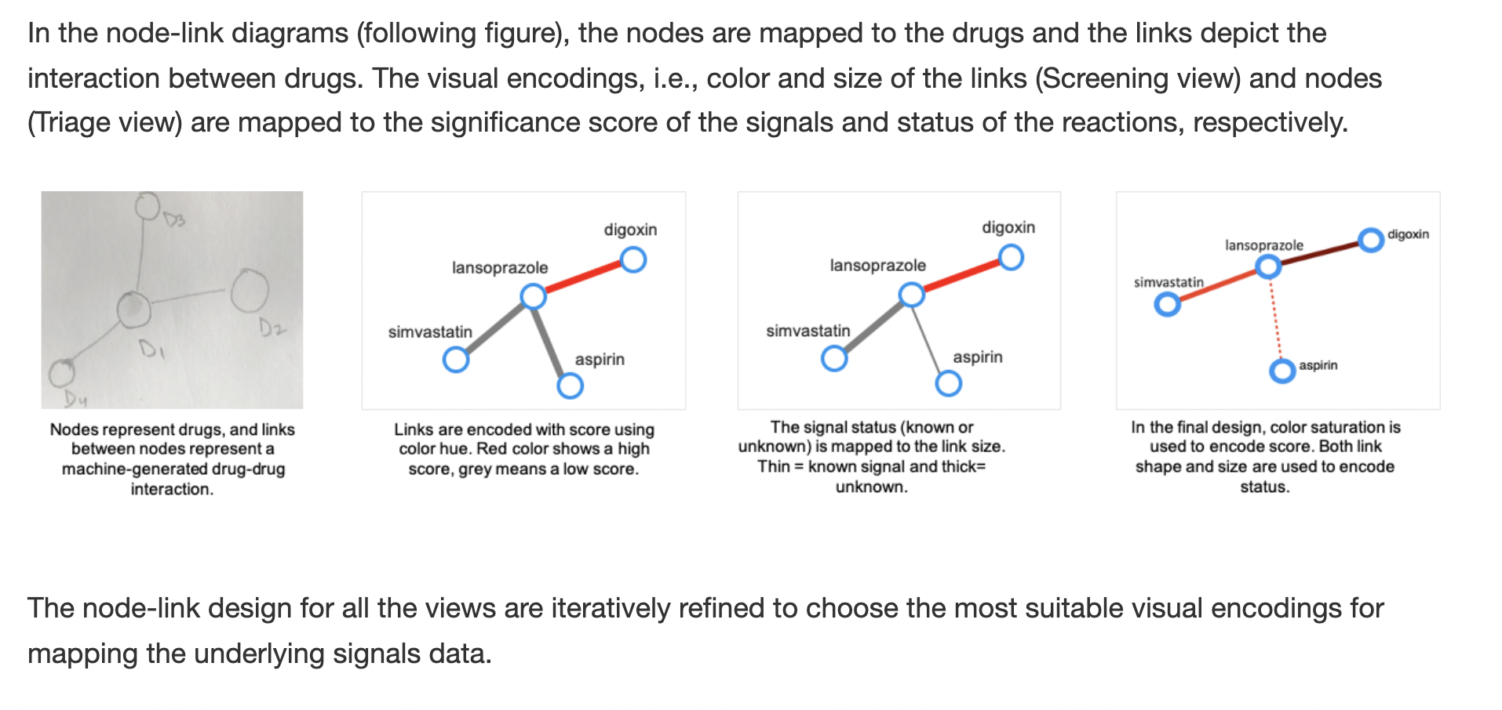
Example: DIVA
https://tkakar.github.io/Website/DIVA.html
Notes:
After this, the authors begin designing. They started with rough sketching of potential options.
One of the things they need to visualization is interactions, or a network, of drugs. They identify two possible ways to visualize this network: and adjacency matrix, and a node link diagram, and ultimately decide the node link diagram is the best option for DIVA.

Slide 35
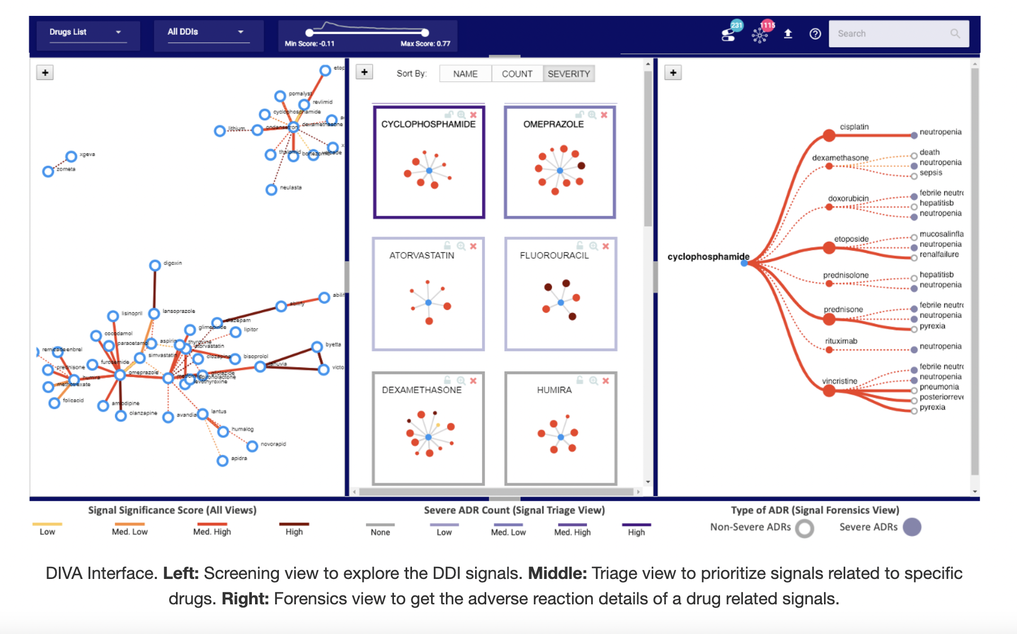
Example: DIVA
https://tkakar.github.io/Website/DIVA.html
Notes:
From there, the author eventually move into designing a fully fledges tool, that in the end looks like this.

Slide 36
Visualization Design Pipeline
Human-Centered, Iterative Design
Design
Evaluate
Validation
Munzner’s Nested Model
Notes:
So, I hope those examples helped highlight the iterative nature of visualization design and the importance of doing human-centered work. Those are the two main things I want you to take away form todays lesson and they are two things that will be important to remember as we move forward with designing and building custom visualizations.

Slide 37

Visualization Design Pipeline
Human-Centered, Iterative Design
Design
Evaluate
Validation
Munzner’s Nested Model
Notes:
So, I hope those examples helped highlight the iterative nature of visualization design and the importance of doing human-centered work. Those are the two main things I want you to take away form todays lesson and they are two things that will be important to remember as we move forward with designing and building custom visualizations.

Slide 38
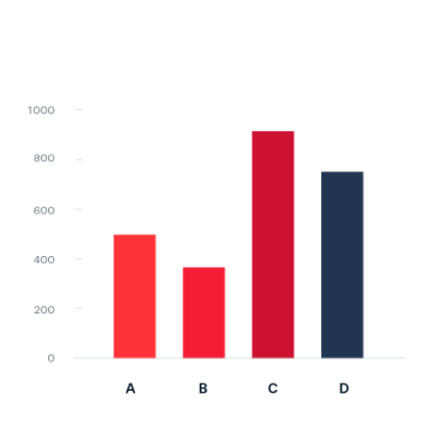
(Low-level) Tasks & Visual Encodings
What task(s) do bar charts support?
Validation
https://datavizproject.com/#
Notes:
What do we use bar charts for?

Slide 39
(Low-level) Tasks & Visual Encodings
Low-level Bar Chart Tasks:
- Comparisons across groups
Validation
https://datavizproject.com/#
Notes:
So, I hope those examples helped highlight the iterative nature of visualization design and the importance of doing human-centered work. Those are the two main things I want you to take away form todays lesson and they are two things that will be important to remember as we move forward with designing and building custom visualizations.

Slide 40
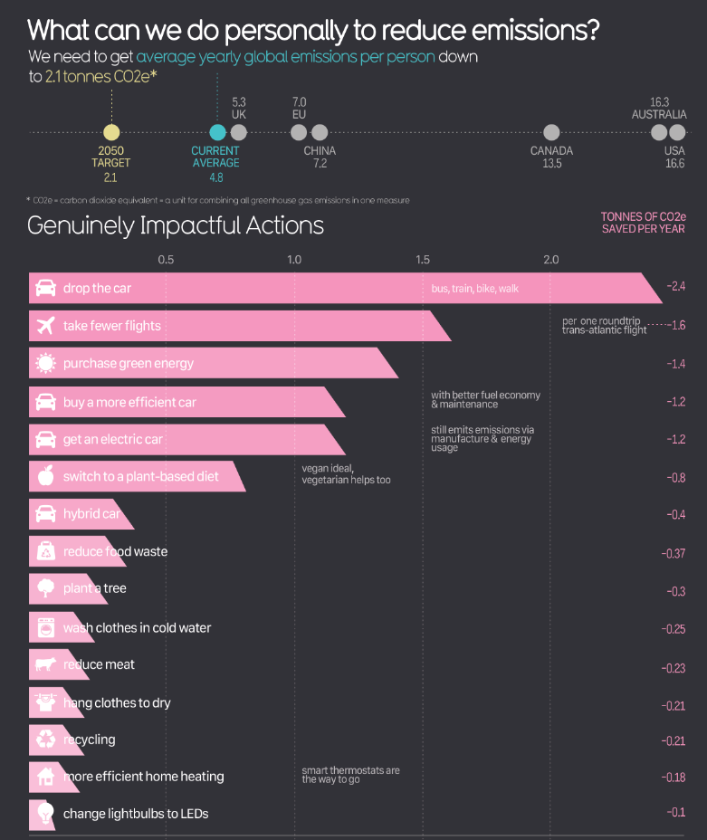
(Low-level) Tasks & Visual Encodings
What is the take-away from this chart?
What domain task might it support?
Validation
https://informationisbeautiful.net/visualizations/what-can-we-do-personally-to-reduce-emissions/
Notes:
So, I hope those examples helped highlight the iterative nature of visualization design and the importance of doing human-centered work. Those are the two main things I want you to take away form todays lesson and they are two things that will be important to remember as we move forward with designing and building custom visualizations.

Slide 41
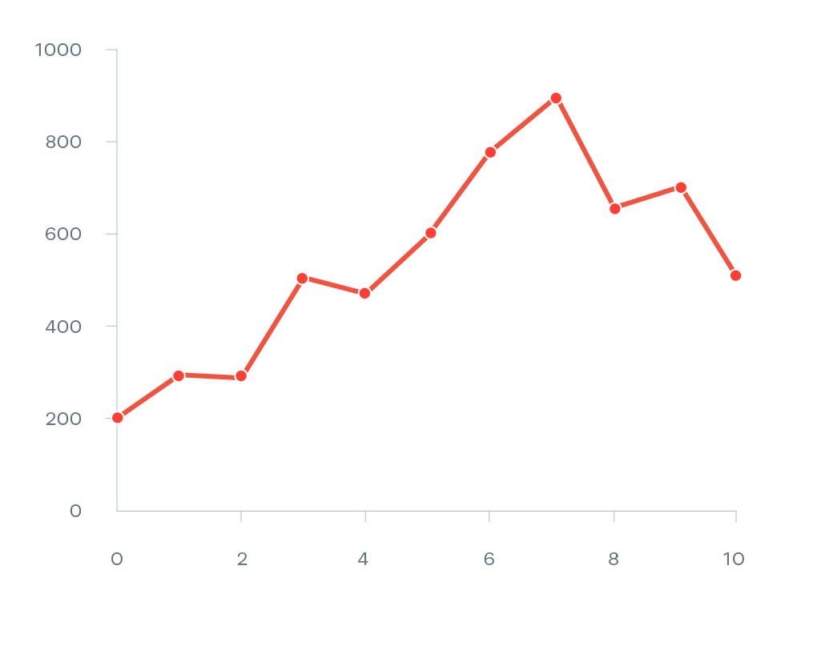
(Low-level) Tasks & Visual Encodings
What task(s) do line charts support?
https://datavizproject.com/#
Notes:
So, I hope those examples helped highlight the iterative nature of visualization design and the importance of doing human-centered work. Those are the two main things I want you to take away form todays lesson and they are two things that will be important to remember as we move forward with designing and building custom visualizations.

Slide 42
(Low-level) Tasks & Visual Encodings
Low-level Line Chart Tasks:
- Trend over time
https://datavizproject.com/#
Notes:
So, I hope those examples helped highlight the iterative nature of visualization design and the importance of doing human-centered work. Those are the two main things I want you to take away form todays lesson and they are two things that will be important to remember as we move forward with designing and building custom visualizations.

Slide 43
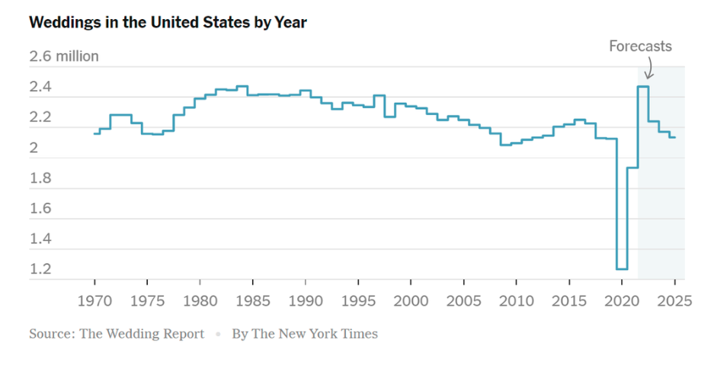
(Low-level) Tasks & Visual Encodings
What is the take-away from this chart?
What domain task might it support?
https://www.nytimes.com/2022/02/10/learning/whats-going-on-in-this-graph-feb-16-2022.html
Notes:
So, I hope those examples helped highlight the iterative nature of visualization design and the importance of doing human-centered work. Those are the two main things I want you to take away form todays lesson and they are two things that will be important to remember as we move forward with designing and building custom visualizations.

Slide 44

(Low-level) Tasks & Visual Encodings
What task(s) do parallel set charts support?
https://datavizproject.com/#
Notes:
So, I hope those examples helped highlight the iterative nature of visualization design and the importance of doing human-centered work. Those are the two main things I want you to take away form todays lesson and they are two things that will be important to remember as we move forward with designing and building custom visualizations.

Slide 45
(Low-level) Tasks & Visual Encodings
Low-level Parallel Set Chart Tasks:
- Movement between groups
https://datavizproject.com/#
Notes:
So, I hope those examples helped highlight the iterative nature of visualization design and the importance of doing human-centered work. Those are the two main things I want you to take away form todays lesson and they are two things that will be important to remember as we move forward with designing and building custom visualizations.

Slide 46
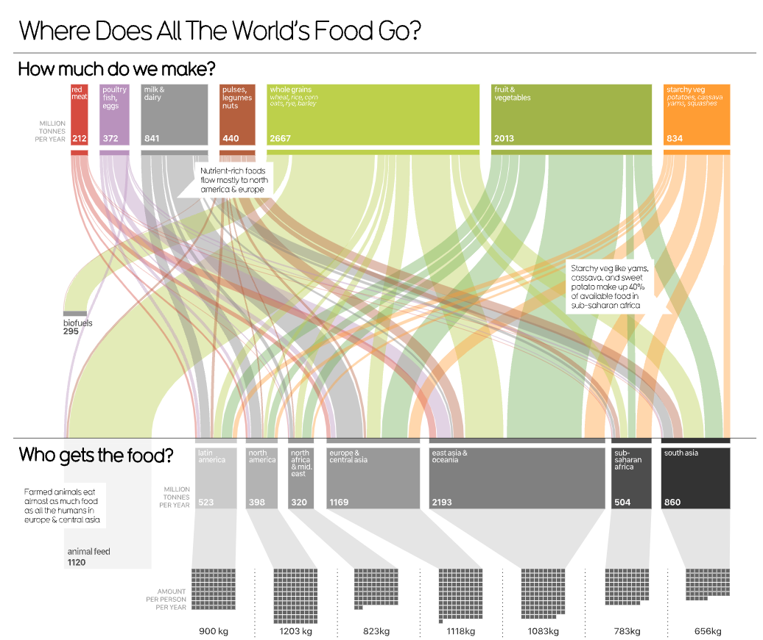
(Low-level) Tasks & Visual Encodings
What is the take-away from this chart?
What domain task might it support?
https://informationisbeautiful.net/visualizations/global-food-supply-where-does-all-the-worlds-food-go/
Notes:
So, I hope those examples helped highlight the iterative nature of visualization design and the importance of doing human-centered work. Those are the two main things I want you to take away form todays lesson and they are two things that will be important to remember as we move forward with designing and building custom visualizations.

Slide 47
Let’s take a break! Stretch, go for a walk, be social ☺ Be back here in 10 mins.

Slide 48
Finish ic-01

Slide 49
Summary
Today we:
Reviewed Visualization Design Pipeline
Finished ic-01
ic-01 is DUE today.
hw-01 is OUT today.

